Slide 1



Business Intelligence Project Apartment Rental Data Analysis
16.05.2025
Fallah Mohammad Mahdi, Muller Nicolai, Seibert Jakob, Seo Jiyoung

Slide 2
Agenda
01 Data Selection
02 BI Justification and Focus
03 Data Modeling
04 Data Processing
05 Data Analytics
06 Key Insights & Reflection

Slide 3
01 Data Selection
Chosen Topic : Apartment Rental Market in Germany and Poland
Both datasets share key variables such as size, rooms, rent, balcony and date.
They can be easily integrated into a common star schema, enabling meaningful cross-country and time-based analysis.
Dataset Overview
 | 1. Apartment rental offers in Germany | 2. Apartment Prices in Poland
Description | Rental offers from Immoscout24 in Germany | Rent offers from the 15 largest cities in Poland
Number of Files | 1 | 8
Rows | 268,850 | 69,920
Columns | 49 | 28
Time Range | from the dates 2018-09-22, 2019-05-10 and 2019-10-08. | 8 months(November 2023 and June 2024)
Source | Kaggle (https://www.kaggle.com/datasets/corrieaar/apartment-rental-offers-in-germany?resource=download) | Kaggle (https://www.kaggle.com/datasets/krzysztofjamroz/apartment-prices-in-poland/data?select=apartments_pl_2024_03.csv)
Fact Table Definition
One entry : Rent for an apartment on a specific date in Germany or Poland, with a given living space size(m2), Number of rooms, balcony status(Yes/No)
Measures : Rent price(transformed by purchasing power)
Dimensions
Date
Country
Apartment
Rent category

Slide 4
02 BI Justification
Analytical Objective
The goal is to support data-driven decision making for both real estate investors and renters in Germany and Poland.
Analyze how features like balcony, room count, and size affect rent, and compare PPP-adjusted price ranges between the two countries.
Analytical Questions
What is the minimum, maximum or average rent per country?
How do rent prices per square meter compare between Germany and Poland?
Does a balcony have a stronger influence on the rent price in Poland or Germany (if it has one)?
What influence does a balcony have on the rent of an apartment?
What influence does the number of rooms have on the rent? Is the relationship linear?
How do rent categories (e.g., <500, 500–1000) relate to number of rooms and apartment size?
Benefits
Investors Perspective:
Gain insights into which apartment attributes (e.g., size, balcony, room count) most significantly impact rent prices
Use this information to identify features that maximize rental income and ROI when investing in properties.
Renter Perspective:
Understand which apartment features have the greatest influence on rental costs.
Make smarter decisions by avoiding unnecessary attributes (e.g., "Do I really need a balcony?")
Cross-Country Market Perspective:
Analyze how country-level differences affect housing prices

Slide 5
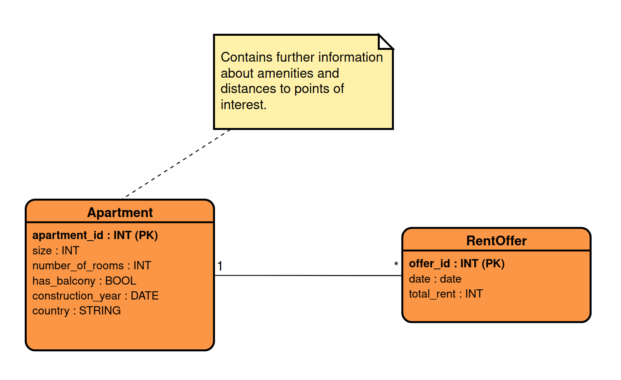
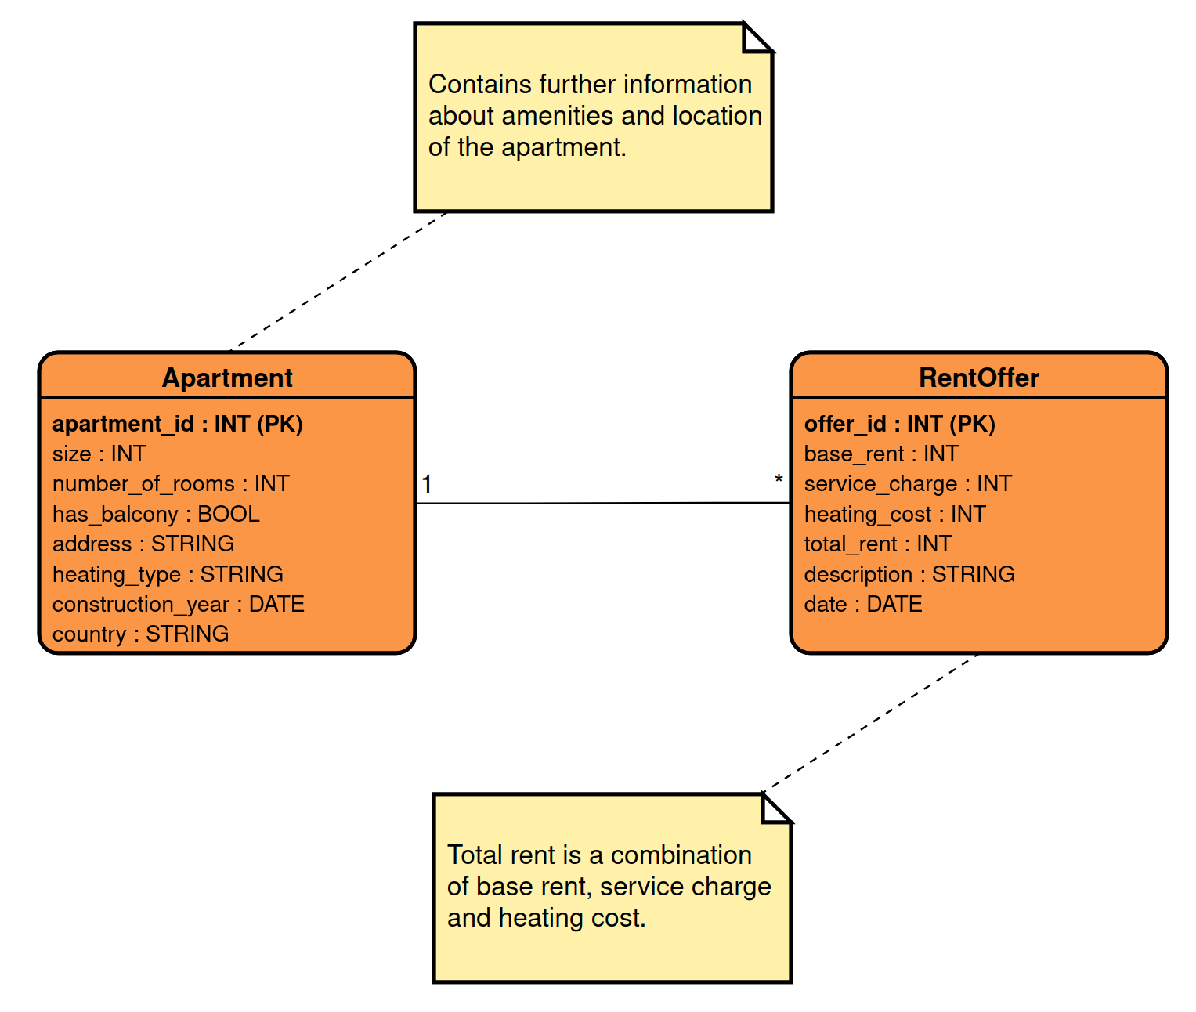
03 Data Modeling
Source Data
Entity-Relationship Models show the original structure of two source datasets(normalized form, 3NF)
 | 1. Apartment rental offers in Germany | 2. Apartment Prices in Poland
Columns | Apartment : size, number_of_rooms, has_balcony, address, heating_type, construction_year, country. RentOffer : base_rent, service_charge, heating_cost, date, description | Apartment : Size, number_of_rooms, has_balcony, construction_year, country. RentOffer : date, total_rent
ER model

Slide 6
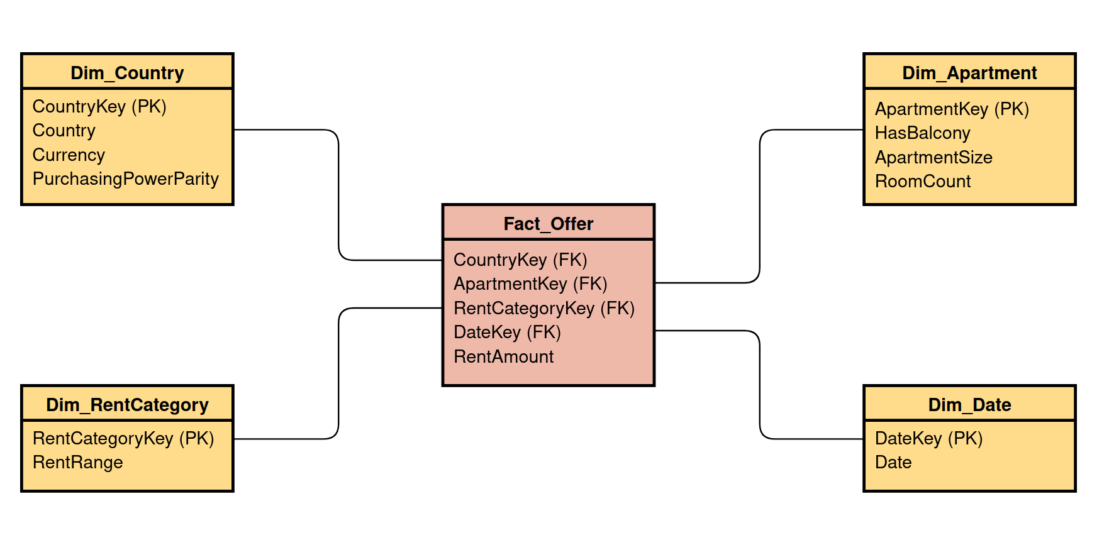
03 Data Modeling
BI Data
 | 1. Apartment rental offers in Germany | 2. Apartment Prices in Poland
Columns Choices | Features like balcony, room count, and apartment size were included because they are directly linked to the analytical questions, such as understanding their impact on rent and comparing pricing patterns. Variables such as heating type, description, or exact address were excluded since they do not contribute to answering the defined questions and are either inconsistent or unstructured across datasets.
Used Columns | Balcony(Boolean) : indicating whether the apartment has a balcony totalRent(int) : indicating price in € livingSpace(int) : indicating size in sqm noRooms(int) : indicating number of rooms Date(date) : indicating when the data was scraped
Dimensions Description | Country : Country-level metadata including name, currency, and purchasing power parity (PPP) factor for rent adjustment. Apartment : Apartment features that influence rental price, such as size, number of rooms and balcony. Rent Category : Classifies rent price into defined categories (e.g., <500, 500–1000) for aggregated analysis and visualization. Date : Date information for each rental entry, enabling time-based analysis.
Star Schema

Slide 7
04 Data Processing
Data Transformation Steps
Created reusable transformation pipeline in Python for reproducibility
The pipeline was written in Python with reusable logic, using loops and standardized cleaning steps.
No manual cleaning was done in spreadsheets or Tableau. All transformations were handled programmatically.
1
Data Collection
- Downloaded raw data from Kaggle using kagglehub.
- Loaded 1 CSV file for Germany and 8 monthly rental files for Poland.
- All Poland rental CSVs were merged into one DataFrame after extracting dates from filenames.
2
Data Selection & Processing
- Selected only relevant columns from both datasets
- Germany : Filled missing totalRent values using baseRent + serviceCharge + heatingCosts
- Poland : Converted rent from PLN to EUR (price * 0.23)
3
Data Integration
- Renamed and aligned column names across both datasets for consistency
- Combined German and Polish data into a single dataframe
- Unified structure: size, number_of_rooms, balcony, elevator, floor, construction_year, date, total_rent, country
4
Data Cleaning
- Outliers (rent price < 300 or > 20,000)
- Non-integer room counts
- Apartments with more than 10 rooms
5
Star Schema Construction
- Constructed four dimension tables from the cleaned dataset(country, apartment, date, rent category)
- Created fact_offer table by joining the cleaned dataset with all dimension tables using foreign keys
- Exported all tables as CSVs for loading into Tableau.

Slide 8
05 Data Analytics

Slide 9
06 Key Insights

Slide 10
07 Reflections
Notes:
For each task, describe your results as well as key choices that you made and/or diOiculties that you encountered. Use a combination of visualizations and bullet points.
Reflection slide: At the end of your slide deck, include a slide in which you reflect on your solution: How good is it? What else could be done (given more time/data/technology)? Work distribution slide: Finally, include a slide in which you briefly discuss the contributions of each group member to the assignment.

